Slide 1
API Testing

Slide 2
What is Client & Server
Client:
A client is a computer hardware device or software that accesses a service made available by a server. The server is often (but not always) located on a separate physical computer.
Server:
A server is a physical computer dedicated to run services to serve the needs of other computers. Depending on the service that is running, it could be a file server, database server, home media server, print server, or web server.

Slide 3

What is Client & Server ?

Slide 4
What is API ?
API is an acronym for Application Programming Interface.
It enables communication and data exchange between two separate software systems. A software system implementing an API contains functions/sub-routines which can be executed by another software system.

Slide 5
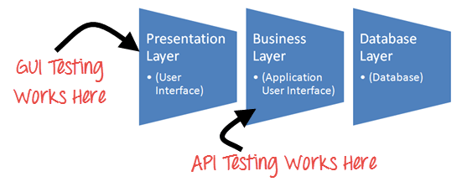
What is API ?

Slide 6
What is API Testing?
API Testing is entirely different from GUI Testing and mainly concentrates on the business logic layer of the software architecture. This testing won't concentrate on the look and feel of an application.
Instead of using standard user inputs(keyboard) and outputs, in API Testing, you use software to send calls to the API, get output, and note down the system's response.

Slide 7
Major Advantages of API Testing
1.Time Effective
In GUI, completion took 50 hours but just 8.5 hours in API.
2.Language independant
Data is exchanged via XML or JSON,so any core language can be used for AUTOMATION.
3.EASY GUI INTEGRATION
With API testing, you can create new users within the application prior to GUI testing.

Slide 8
Tools for API Testing
1.POSTMAN
2.REST-ASSURE
3.SOUP-UI
4.Jmeter

Slide 9
Tools for API Testing
1.POSTMAN
2.REST-ASSURE
3.SOUP-UI
4.Jmeter

Slide 10
What is REST-Assure ?

Slide 11
What is Authentication ?
A process to prove that you authentic person or not.
Rest Assured supports several authentication schemes.
i.e. Oauth, Certificate, form, preemptive basic authentication

Slide 12
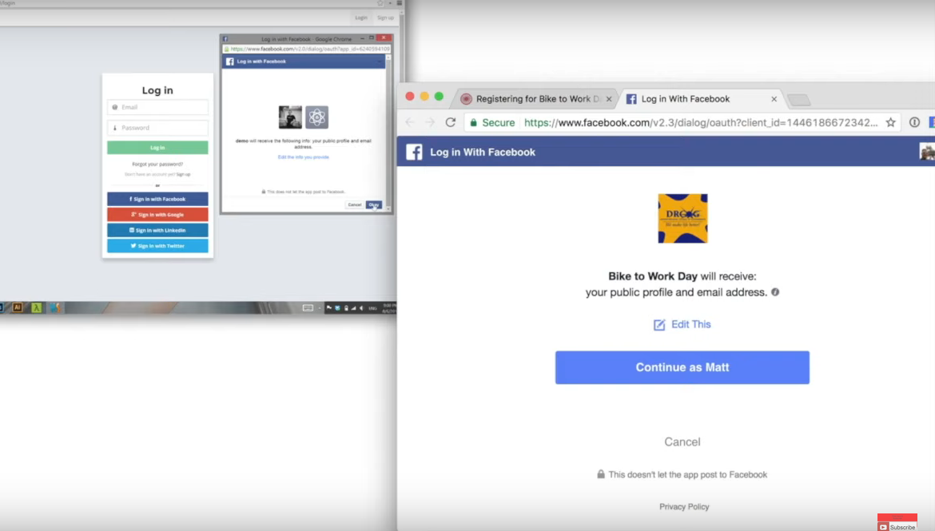
OAuth

Slide 13
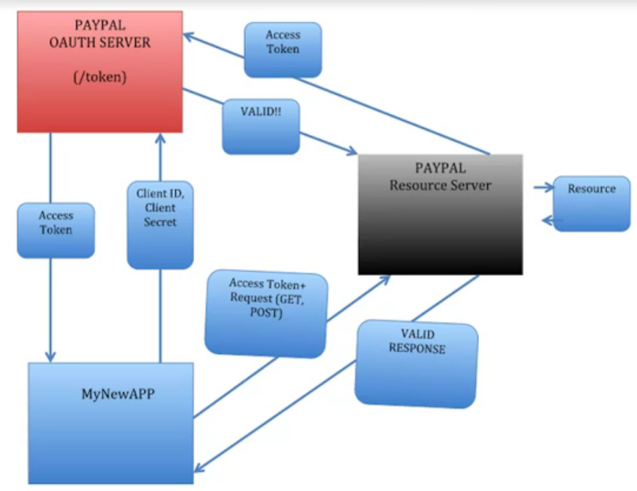
OAuth

